Slide 1
J58 (JT11D-20)
Aponte, Edwin; Lagares, Christian; Quijano, Joel
Department of Mechanical Engineering
INME 4707-030
University of Puerto Rico at Mayaguez

Slide 2
J58 (JT11D-20) – Project Summary
INSERT SUMMARY
Notes:
Quijano

Slide 3
J58 (JT11D-20) – Introduction
To gain a better understanding of turbojet engines it is important to analyze the engine characteristics over a range of condition to fully grasp the capabilities of the engine. To that end, an analytical model will be developed that describes the impact of changes in component characterization on the overall performance of a turbojet engine. This will be done for a range of conditions to survey the design space.
Notes:
Aponte

Slide 4
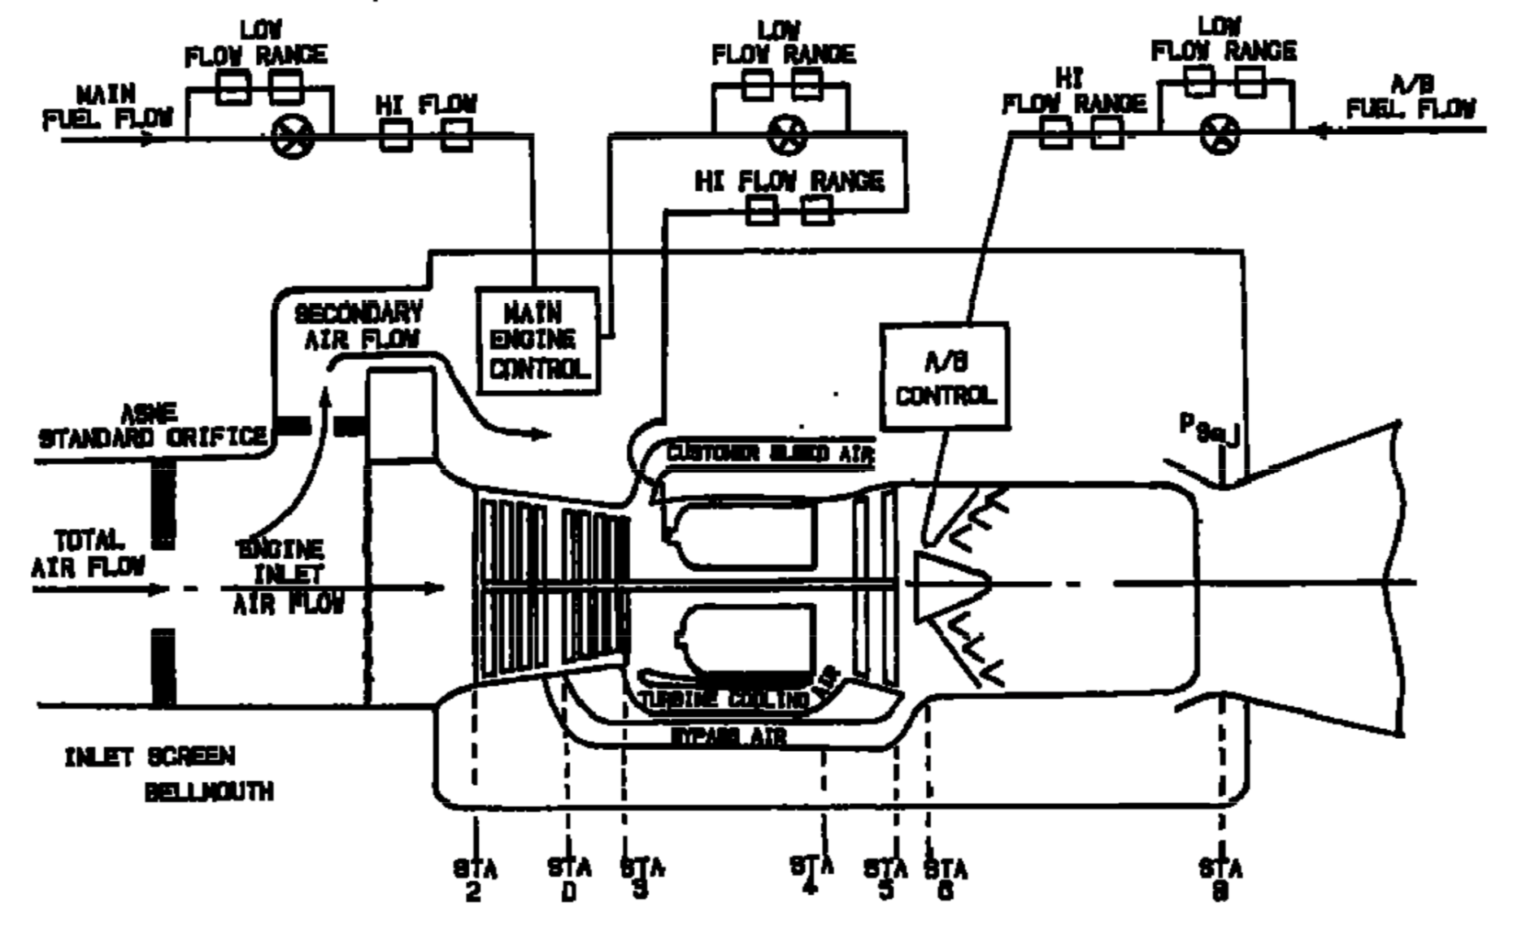
J58 (JT11D-20) – Introduction
Figure 1: Standard J11D-20 Station Nomenclature [1]
Notes:
Lagares

Slide 5
J58 (JT11D-20) – Introduction
Table 1: Maximum Operating Temperatures [1] [2]
COMPONENT/STAGE | TEMP (ºF) | TEMP (ºC)
Inlet T1 | 800+ | 426+
COMPRESSOR Inlet T2 | 800+ | 426+
COMPRESSOR 4th Stage TD | 1050 | 565.56
COMBUSTOR Inlet T3 | 1300 | 704.44
TURBINE Inlet T4 | 2000 | 1093.33
TURBINE Exit T5 | 1450 | 787.78
AB T6 | 3200 | 1760
Exhaust NOZZLE T8 | 1500 | 815.15
Notes:
Lagares

Slide 6
J58 (JT11D-20) – Introduction
Table 2: Engine Specs
SPECIFICATION | VALUE RANGE [EN] | VALUE RANGE [SI]
Altitude [4] | 25K-90K ft | 7.62 – 27.43 km
Speed [5] | Mach 0.75 – 3.2
Dry TSFC @ Max Thrust [6] | 0.8 lb/lbf hr | 81.6 kg/kN hr
Wet TSFC @ Max Thrust [6] | 1.9 lb/lbf hr | 164 kg/kN hr
Fuel [7] | JP-7
Fuel Storage [8] | 80,285 lb | 36,416 kg
Fuel Lower Heating Value [9] | 5.48 kWh/lb | 43,682 kJ/kg
Thrust [7] | 32,500 lbf | 144,567 N
Air Volume Flow @ Cruise [10] | 100K ft³/s | 2831.68 m³/s
Notes:
Lagares

Slide 7
J58 (JT11D-20) – Introduction
Table 2: Engine Specs (Cont.)
SPECIFICATION | VALUE RANGE [EN] | VALUE RANGE [SI]
Compression Ratio < Mach 2.2 [8] | 8.8:1
Compressor [11] | 8-Stage Axial
Turbine [11] | 2-Stage
Weight [11] | 6,500 lb | 2,948 kg
Air Mass Flow [8] | 326-450 lb/s | 147 – 204 kg/s
Dry Fuel Mass Flow @ Max | 5.55 lb/s | 2.52 kg/s
Wet Fuel Mass Flow @ Max | 17.94 lb/s | 8.14 kg/s
Dry Fuel to Air Ratio | 0.012-0.017
Wet Fuel to Air Ratio | 0.0398-0.055
Notes:
Lagares

Slide 8
J58 (JT11D-20) – Introduction
Table 3: Validation Flight Conditions
Condition ID | Altitude [ft] | Mach | Afterburner
Takeoff [2] | 0 (@ Sea level) | 0.3542 | ON
Refueling/Buddy Mission [2] | 25000 | 0.75 | OFF
Climbing [2] | 30000 | 1.25 | ON
Concorde [12] | 60000 | 2.00 | ON
YF12A (03/18/65) | 65000 | 2.2 | ON
A12 Max Altitude at Mach 2.2 | 75000 | 2.2 | ON
Lake County Airport | 9928 | 0.3545 | ON
Lowest Altitude at Mach 1.0 | 15000 | 1.0 | ON
MA139-XAA | 40000 | 1.9 | ON
French Griffon II[] | 61000 | 2.1 | ON
Constant climb | 33000 | 0.9 | ON
Supersonic transport flight | 70000 | 2.5 | OFF
Notes:
Lagares

Slide 9
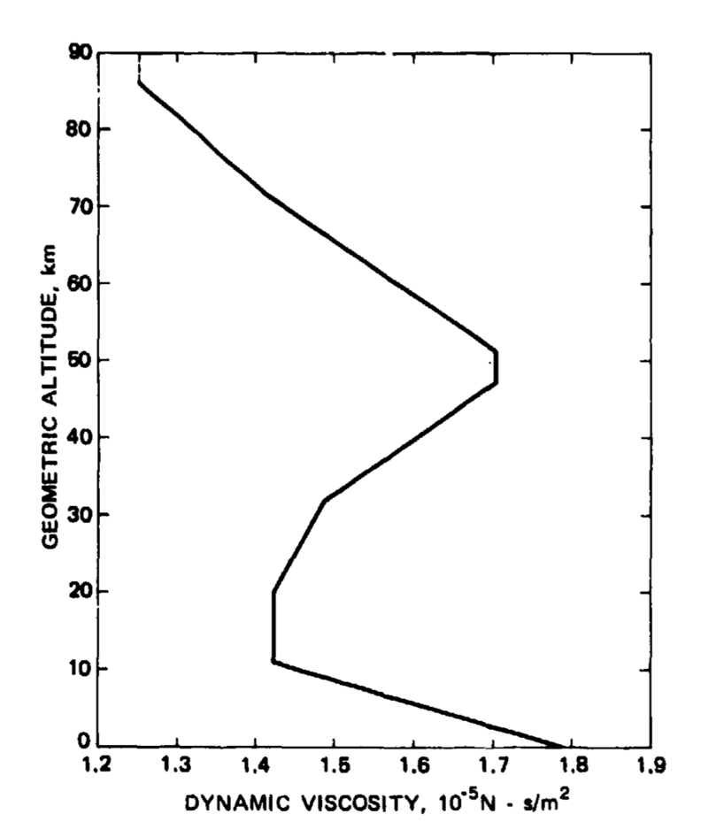
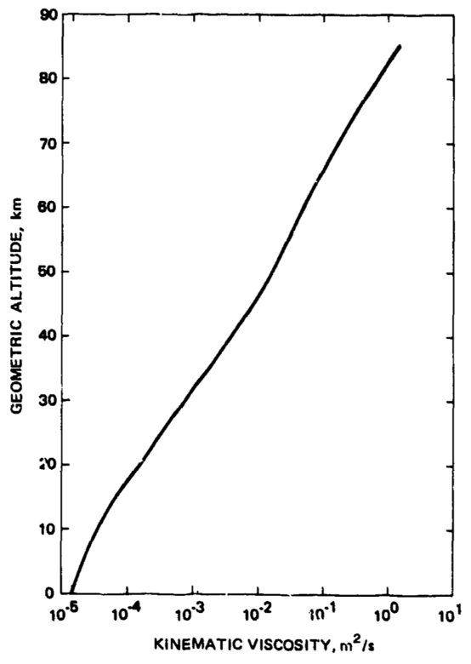
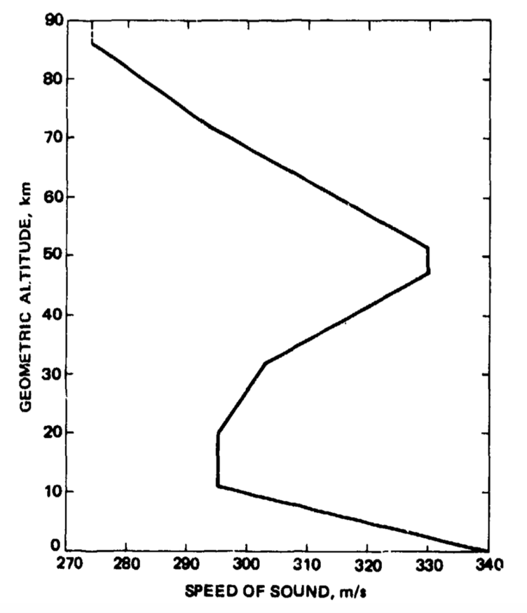
J58 (JT11D-20) – Standard Atmosphere
Figure 2-4: Standard Atmosphere Dynamic Viscosity, Kinematic Viscosity and Speed of Sound [15]
Notes:
Lagares

Slide 10
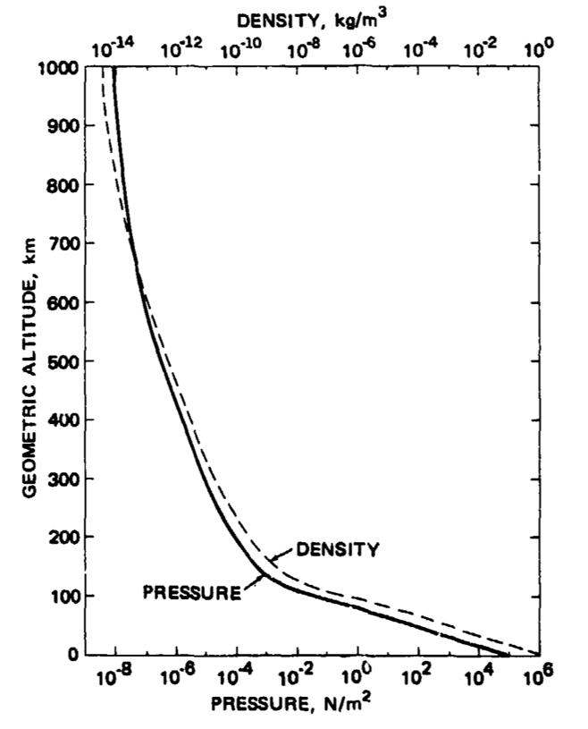
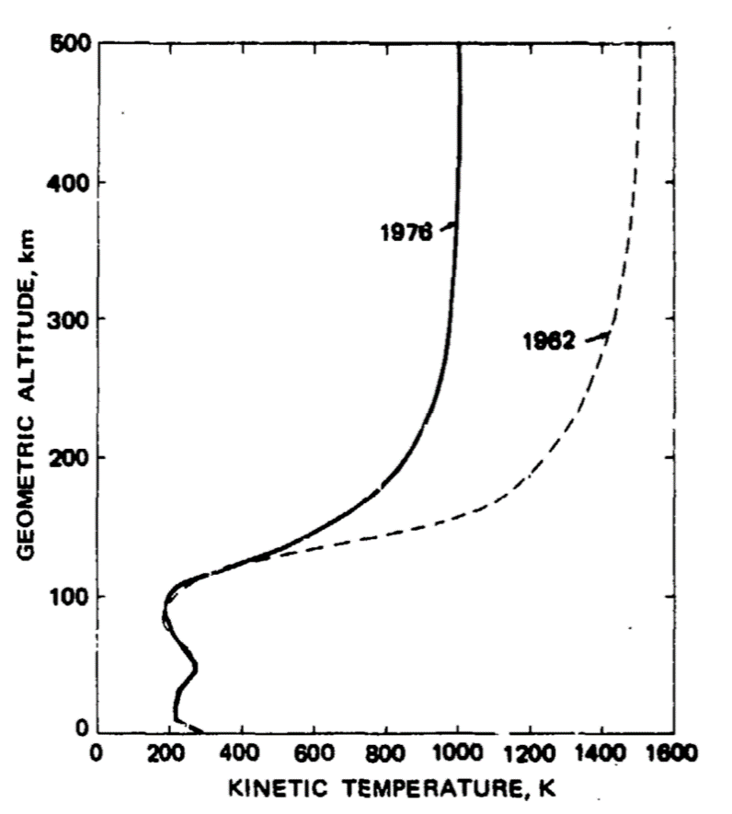
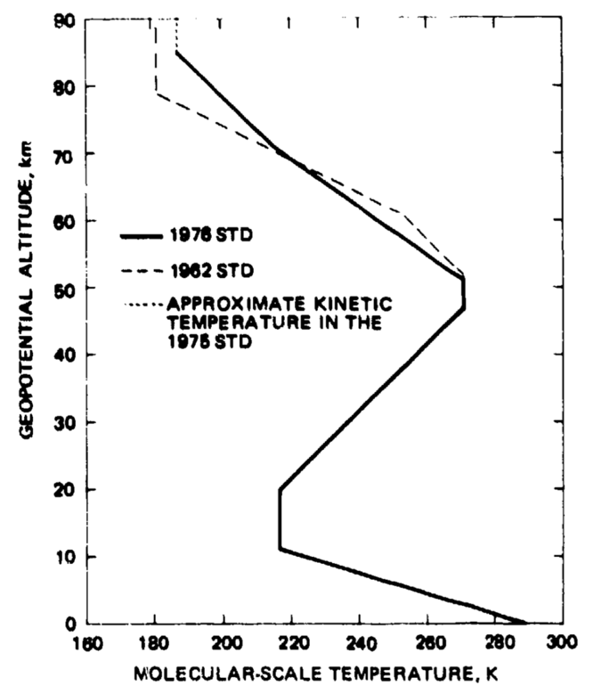
J58 (JT11D-20) – Standard Atmosphere
Figure 5-7: Standard Atmosphere Pressure, Kinetic Temperature and Molecular-Scale Temperature [15]
Notes:
Lagares

Slide 11
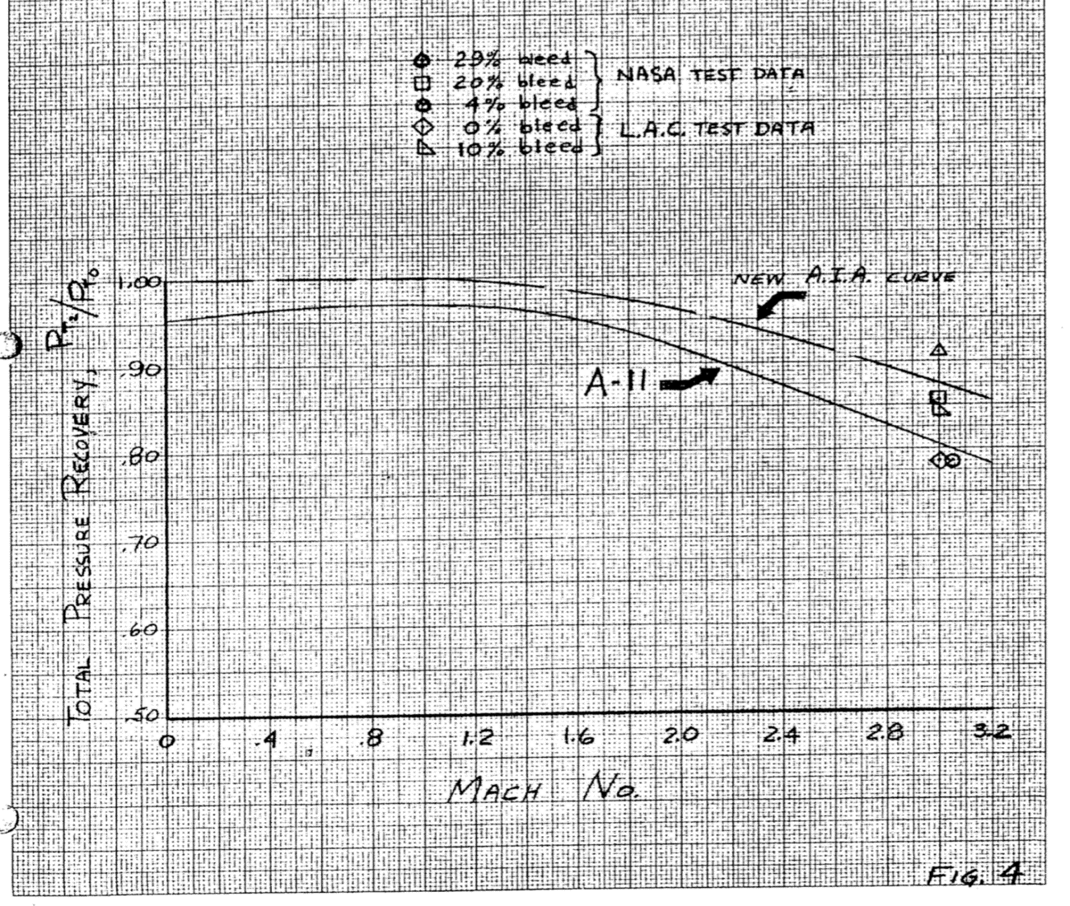
J58 (JT11D-20) – Inlet
Figure 8: Expected Inlet Performance [16]
Notes:
Lagares

Slide 12
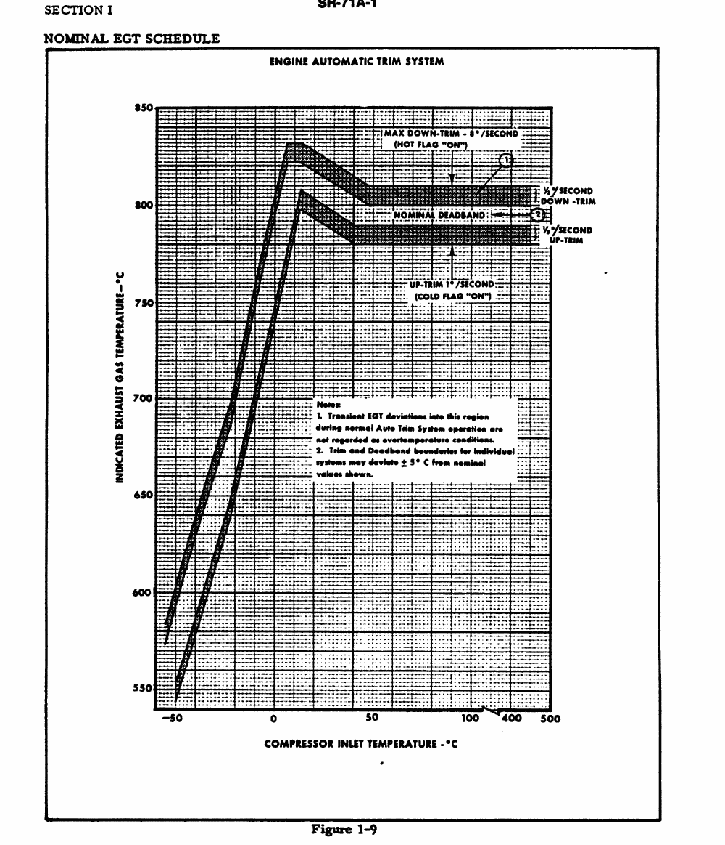
J58 (JT11D-20) – EGT
Figure 9: Indicated EGT vs Compressor Inlet Temperature [2]
Notes:
Lagares

Slide 13
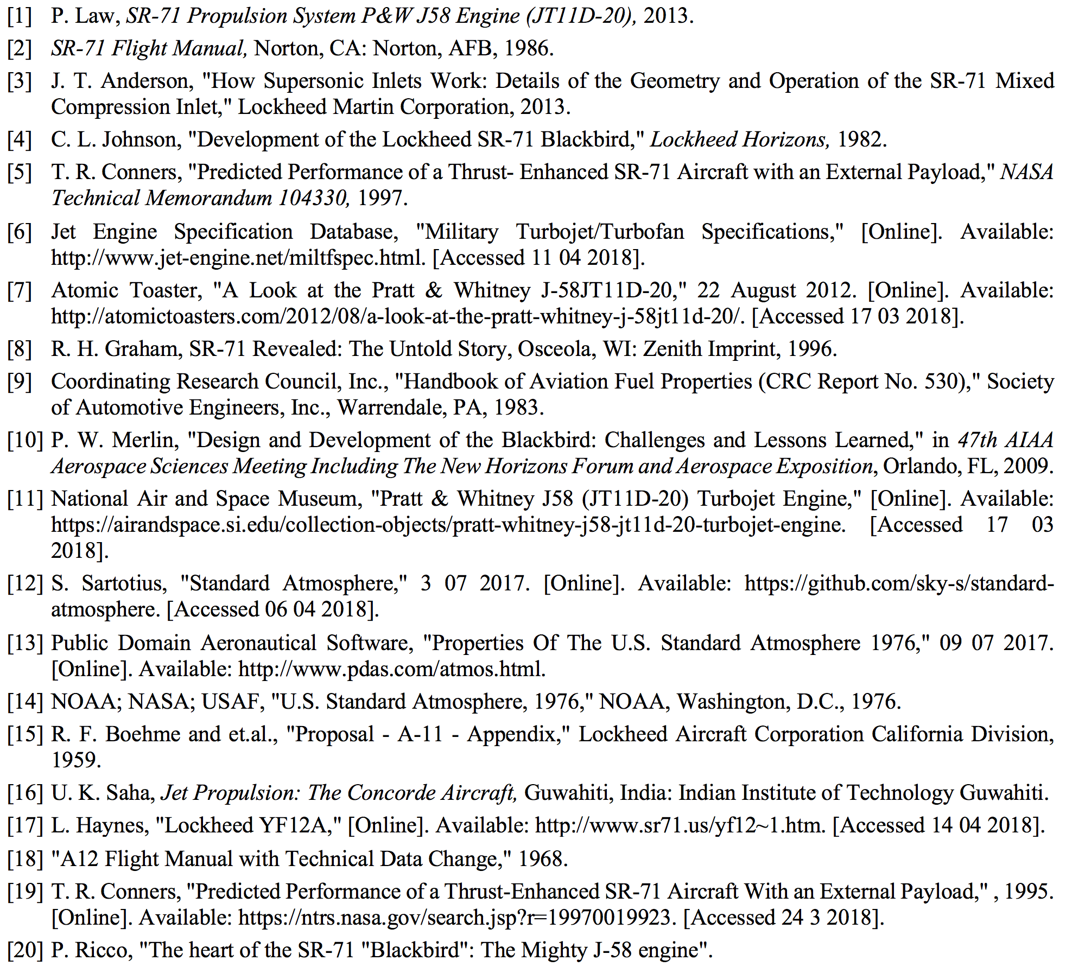
References
Notes:
Lagares/Aponte

Slide 14


